Slide 1
PerfTest: Implementation
Yoonki Song
Last Updated: 10/7/2009

Slide 2
TPTP
Analyzing TPTP Source Code

Slide 3
TPTP CVS Repository
TPTP (The Latest Source) CVS Repository
:pserver:anonymous@dev.eclipse.org:/cvsroot/tptp

Slide 4
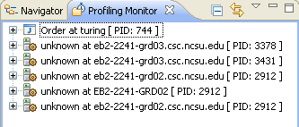
TPTP UI
Plugin: /org.eclipse.hyades.trace.ui
Class name: org.eclipse.hyades.trace.internal.ui.PDProjectExplorer (“Profiling Monitor” viewpart)

Slide 5
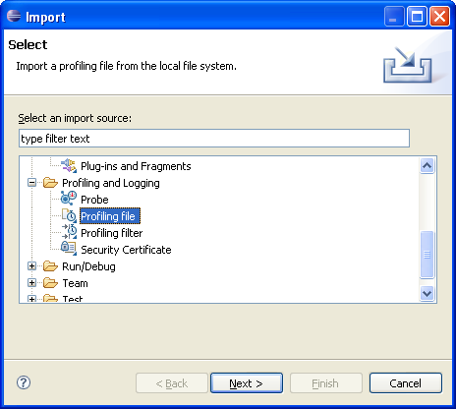
TPTP UI
Plugin: /org.eclipse.hyades.trace.ui
Class name: org.eclipse.hyades.trace.ui.internal.wizard. ImportTracePage1 (“Profiling File” wizard page)

Slide 6
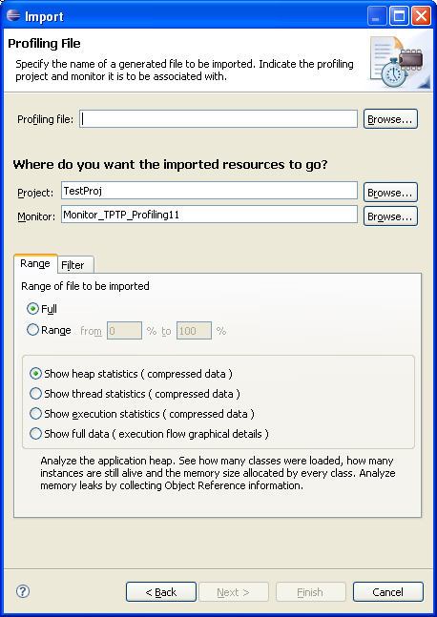
TPTP UI

Slide 7
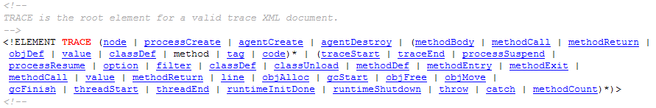
Trace.dtd
http://www.eclipse.org/tptp/platform/documents/resources/profilingspec/trace.dtd.html
…

Slide 8
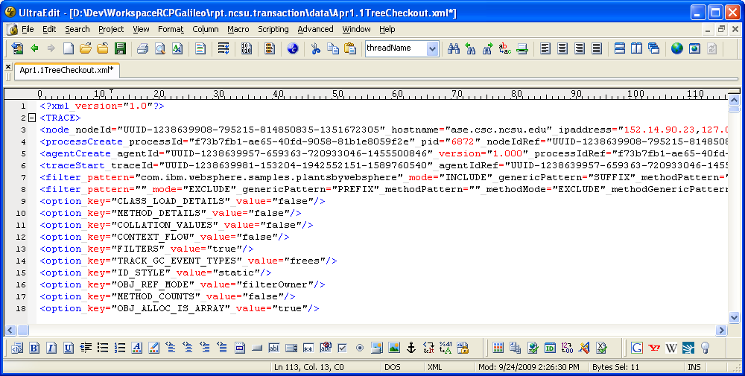
An Example of Trace File

Slide 9
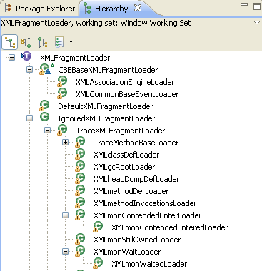
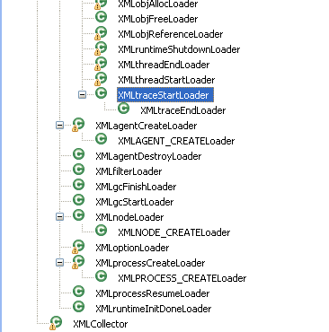
Analyzing Trace files in EMF

Slide 10
Loading Trace.dtd
XML Tag “traceStart”
Plugin: org.eclipse.hyades.models.trace
Class name: org.eclipse.hyades.loaders.trace. TraceXMLLoadersFactory

Slide 11
Loading Trace.dtd (Cont’d)
org.eclipse.hyades.models.hierarchy
org.eclipse.hyades.loaders.util.XMLLoader
org.xml.sax.SAXParseException
import javax.xml.parsers.ParserConfigurationException;
import javax.xml.parsers.SAXParser;
import javax.xml.parsers.SAXParserFactory;
import org.eclipse.hyades.models.hierarchy.util.ModelDebugger;
import org.xml.sax.Attributes;
import org.xml.sax.InputSource;
import org.xml.sax.Locator;
import org.xml.sax.SAXException;
import org.xml.sax.SAXParseException;
import org.xml.sax.helpers.DefaultHandler;

Slide 12
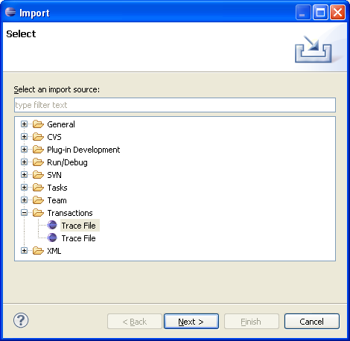
Importing Trace Files (from NUO)

Slide 13
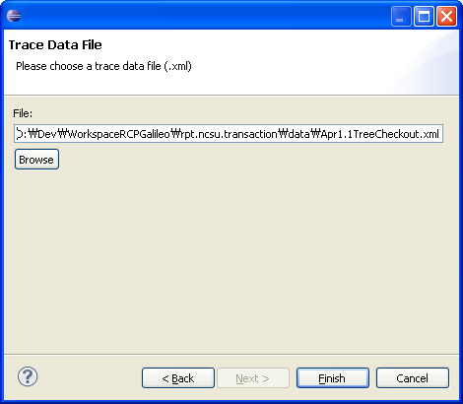
Importing Trace Files (from NUO)

Slide 14
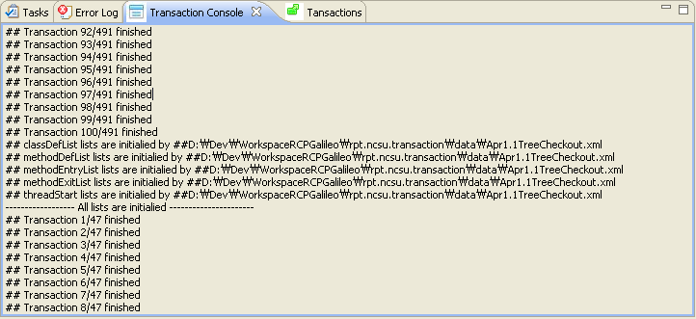
Transaction Console (from NUO)

Slide 15
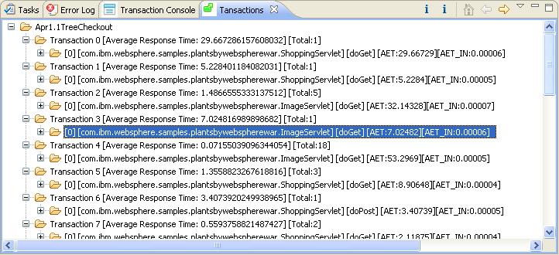
Transaction (from NUO)

Slide 16
File extensions
Extension | Description
executiondlr
Trcadlr
Trcaxmi | Trace Agent
Trciovxmi
Trcmxmi | Trace Monitor
Trcnxmi | Trace Node
Trcpxmi | Trace Process
trcxml | (Manual) Trace File

Slide 17
Analyzing Trace Files
How? What? TODO

Slide 18
IPOT
This tool identifies the root cause of poor performance observed during a test by round-trip response time decomposition. The response time is broken down into the times spent within each component in the system under test enabled by the included Tivoli ARM data collector. An updated Data Collection Infrastructure (DCI) version has been posted to run with Rational Performance Tester v6.1.2.

Slide 19
IPOT
Demo
http://www3.software.ibm.com/ibmdl/pub/software/rational/web/demos/ipot_demo.html

Slide 20
References
TPTP 4.5.0 Javadoc
Monitoring Tools
http://archive.eclipse.org/tptp/4.5.0/javadoc/Monitoring_Tools/public/index.html
Plaform
http://archive.eclipse.org/tptp/4.5.0/javadoc/Platform/public/index.html
Testing Tools
http://archive.eclipse.org/tptp/4.5.0/javadoc/Testing_Tools/public/index.html
Tracing and Profiling Tools
http://archive.eclipse.org/tptp/4.5.0/javadoc/Tracing_and_Profiling_Tools/public/index.html

Slide 21
References (Cont’d)
Document Object Model (DOM) Level 3 Core Specification
http://www.w3.org/TR/2004/REC-DOM-Level-3-Core-20040407/
org.w3g.dom Javadoc
http://java.sun.com/javase/6/docs/api/org/w3c/dom/package-summary.html

Slide 22
Comparing Trace data from RPT and TPTP

Slide 23
Start the Plant web application (AppSrv02, 9083, 9063)
Setup the environment for RPT profiling
Create a performance test suite for the Plant web application.
Run the performance test suite by RPT while collecting profiling data by RPT. The profiling data is stored in a local trcxml file (t1_rpt.trcxml)
Restart the Plant web application (after uninstrumentation)
Setup the environment for TPTP profiling
Run the performance test suite by RPT while collecting profiling data by TPTP. The profiling data is stored in a local trcxml file (t1_tptp.trcxml)
Compare t1_rpt.trcxml and t1_tptp.trcxml to figure out the difference.

